Slide 1
ECE 231
Digital Logic Design
Week 3 Recitation
Basic gates, Boolean Algebra
Rifat Bin Rashid
Teaching Assistant
Dept. of ECE, Rutgers University

Slide 2
Boolean Algebra
Found application in engineering after almost 100 years
Introduced by George Boole In 1849
Axioms
Based on a set of rules derived from a small number of basic assumptions- Axioms
Think of Euclidean Geometry

Slide 3
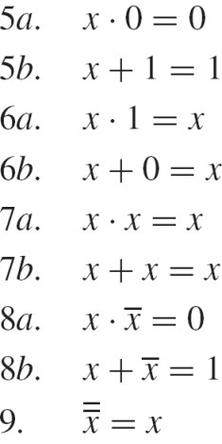
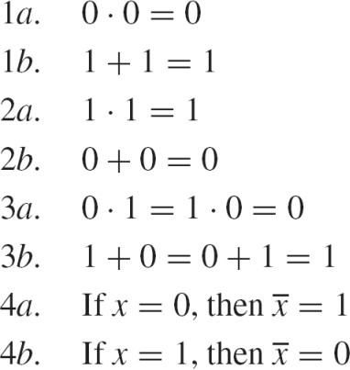
Axioms and Theorems
Axioms
Single Variable Theorems

Slide 4
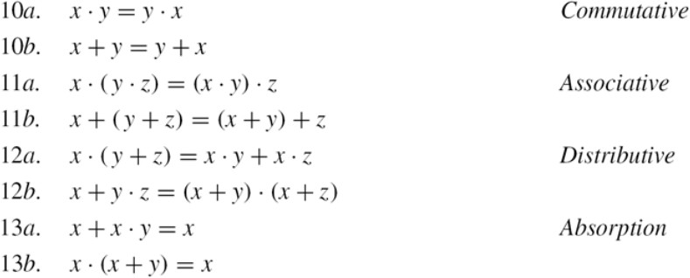
Theorems

Slide 5
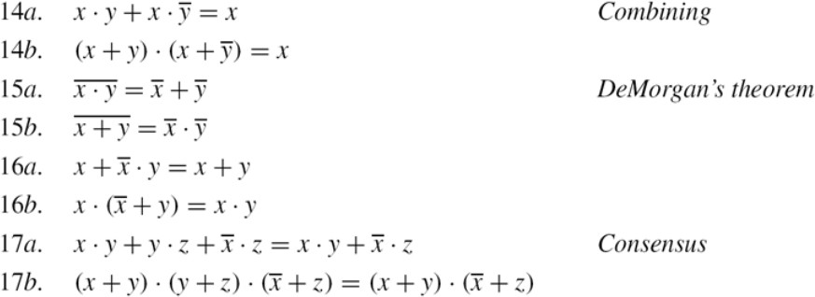
Theorems

Slide 6
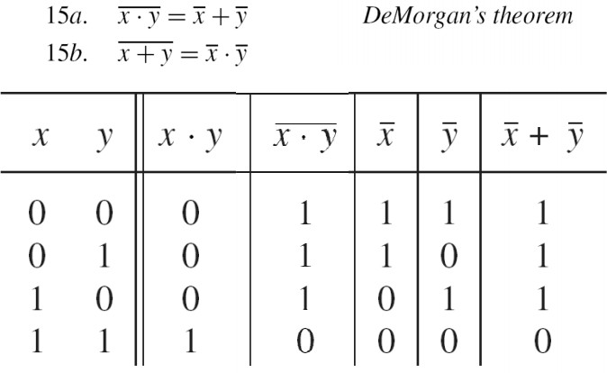
Proof via Truth Table

Slide 7
Precedence of Operations
NAO - Not > And >Or
Always put a parenthesis if you are confused

Slide 8
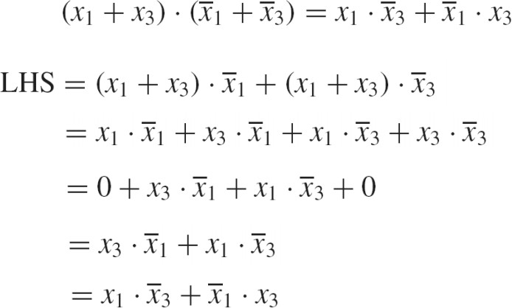
Problem 1

Slide 9
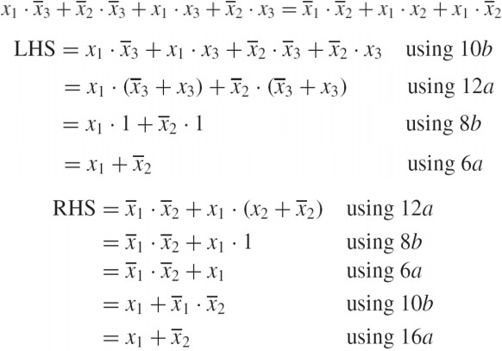
Problem 2

Slide 10
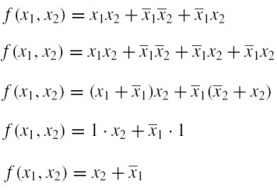
Problem 3

Slide 11
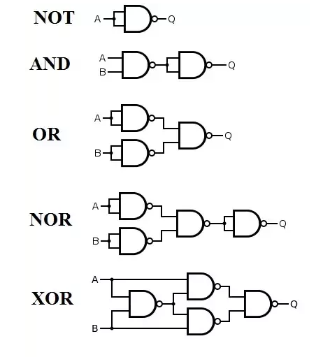
Nand/Nor – Universal gate

Slide 12
Nand/Nor – Universal gate

Slide 13
Summary
Boolean Algebra- Theorems, Application in minimization and proof
Precedence of operations
We will use these a lot!!!

